Slide 1
File Management

Slide 2
__________________________
Is working on 2 or more open programs
Steps:
________________________
________________
MULTITASKING
Right click on the start bar
Show Windows side by side

Slide 3

Methods of Organization
Folder
Sub Folder
Folder
Sub Folder
Sub Folder

Slide 4
Create Folders
Right Click
New Folder
Name Folder

Slide 5
Computer Technology
Excel
Word
PowerPoint
Internet
Computer Basics

Slide 6
How to Delete a file/folder:
___________________
2.___________________
Right Click while file is selected
Delete
Or: select file and click the delete button on your keyboard.

Slide 7
How to Rename a Folder:
1.
2.
Click once over the file/folder & it will allow you to rename it.
Select the file and click F2 on your keyboard

Slide 8
Save / Save As
Save:
Save in existing location
Save As:
Save in a new location

Slide 9
Copy:
Move:
Creates a copy of the file so you now have 2
Move from one location to a different location

Slide 10
To Select Files
CTRL (Control)
  Selects files that are not adjacent to each other
Chapter2.doc
Chapter3.doc
Chapter4.doc
Chapter5.doc
Shift
  Selects files that are adjacent to each other
Chapter2.doc
Chapter3.doc
Chapter4.doc
Chapter5.doc

Slide 11
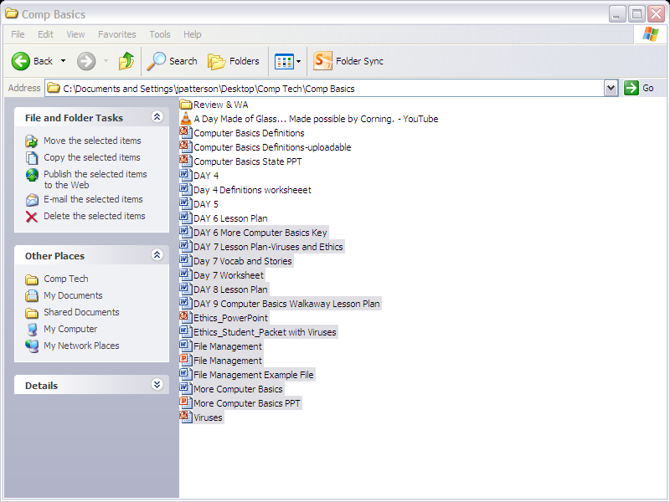

Slide 12
